Slide 1
Announcements!

Slide 2
HW1 is released!
Due Tuesday.
Has both theory (background on algebra, etc.) and programming (word similarity).
A baseline for self-assessment.
Future homework may be more demanding.

Slide 3
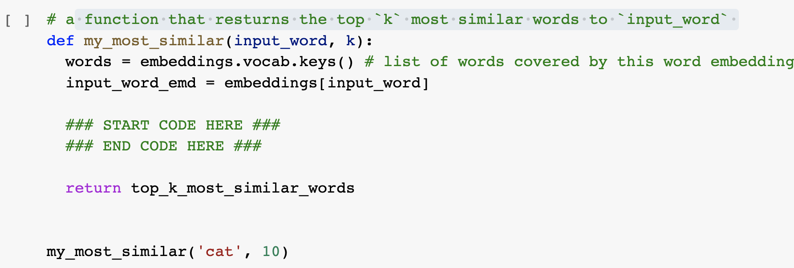
“Can I use external libraries?” No, unless specified!
Use the basic Python functions (no external libraries), unless explicitly specified.
In almost all places, you’re not expected to write more than 3-4 lines of code.

Slide 4
“I can’t install Gensim 3.x.y”
Current code is based on 3.6.0.
If you use other version, you might need to make minor changes to Gensim functions. Feel free to consult with Gensim documentation.
This is part of any programming experience. It's part of the job! Don't hate it, embrace it! 🤗

Slide 5
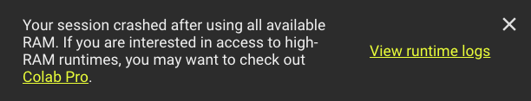
“My Colab Is Running Out of Memory”
Option 1: get a more high-performing Colab: $10 for a month
~ 2 x $ of Starbucks chocolate mochas
~ $ of Twitter verification
Option 2: use smaller word embeddings:
The output will be a bit different but that’s okay!
Note, the smaller vectors have smaller dimensionality.
# download the pre-computed embeddings
# embeddings = gensim.downloader.load('glove-twitter-50')
embeddings = gensim.downloader.load('word2vec-google-news-300')

Slide 6
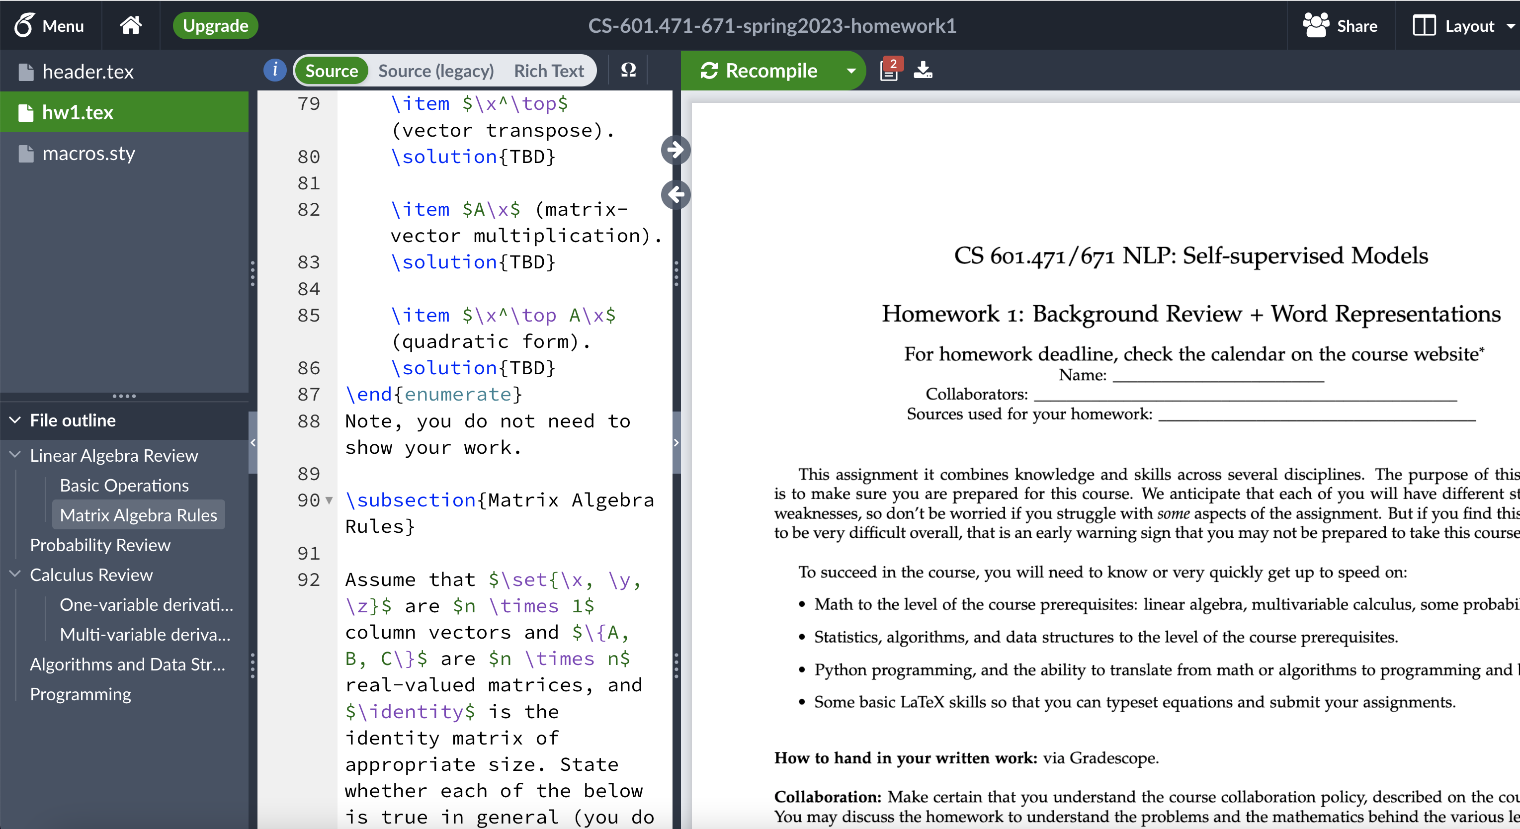
“Is Typesetting Mandatory?” No, but …
But 10x strongly recommended.
It is a must-have skill if you’re considering going to any research field.

Slide 7
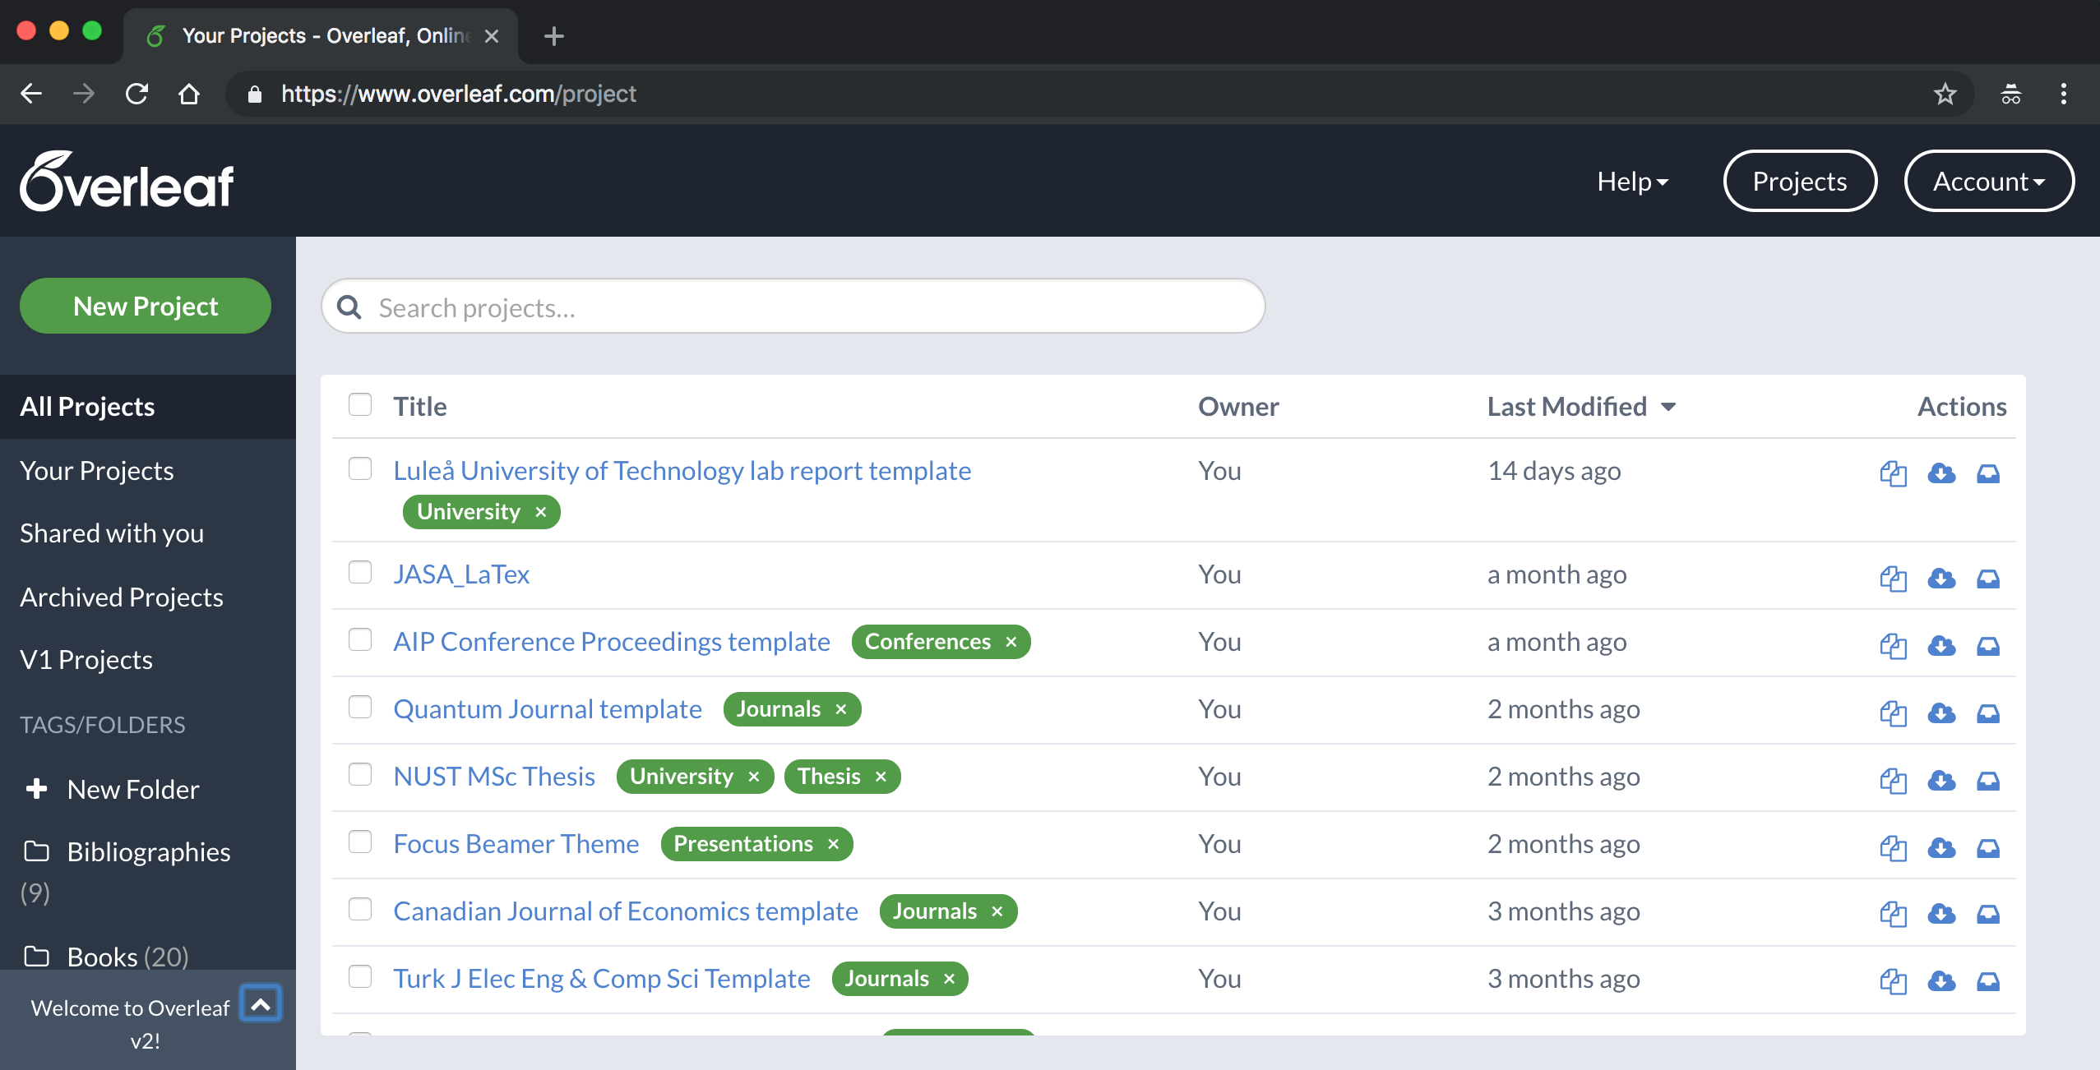
“Is Typesetting Mandatory?"
Go back to Overleaf home and ”copy” the homework template.

Slide 8
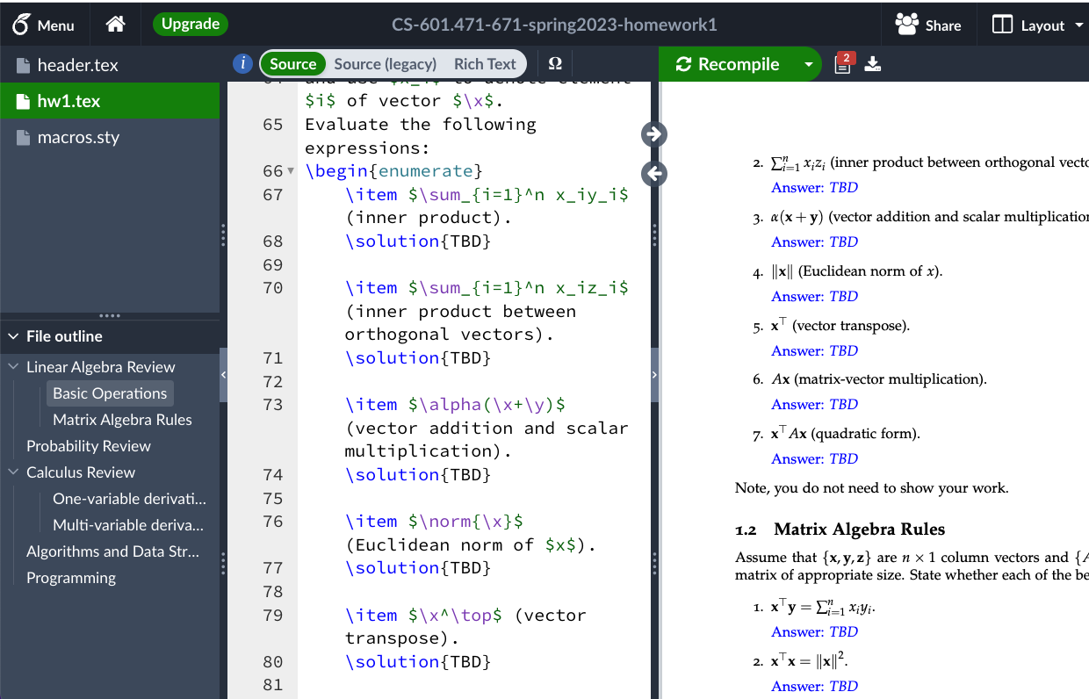
“Is Typesetting Mandatory?"
Go back to Overleaf home and ”copy” the homework template.

Slide 9
Language Modeling
CSCI 601 471/671
NLP: Self-Supervised Models
https://self-supervised.cs.jhu.edu/sp2023/
[Slide credit: Mohit Iyyer, Chris Manning, and many others ]

Slide 10
Motivation
Earlier we define Self-Supervised models as as predictive models of the world!
Word2Vec: Predictive models given word representations.
Now with neural networks: predictive models of word compositions

Slide 11
Chapter Plan
Language modeling: definitions and history
Language modeling with counting
Measuring language modeling quality
Language Modeling with feed-forward networks

Slide 12
The

Slide 13
The cat
Notes:
Then cat

Slide 14
The cat sat
Notes:
sat

Slide 15
The cat sat on
Notes:
on

Slide 16
The cat sat on __?__
Notes:
on

Slide 17
The cat sat on the mat.
Notes:
The …

Slide 18
The cat sat on the mat.
Notes:
mat. Great, so many of you figured out pretty quickly where this sentence was going.

Slide 19
P(mat |The cat sat on the)
next word
context or prefix
Notes:
What you all were doing, roughly, was predicting a probability distribution over the next word in the sentence given the previous words.
By the end of the sentence, you probably were predicting that the word "mat" had a probability near 1 and every other word had relatively low probability

Slide 20
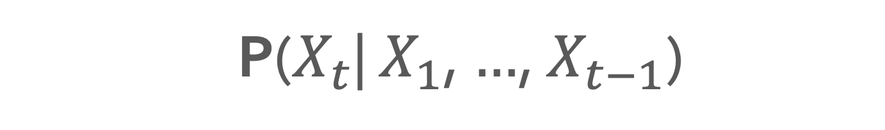
Probability of Upcoming Word
P($X_{t}$| $X_{1}$, $…$, $X_{t−1}$)
next word
context or prefix
Notes:
This is, in fact, fundamentally what autoregressive models do. Given a sequence, which here we are calling y_1, y_2, ... and so on, an autoregressive model tries to predict y_t from all of the sequence entries before y_t.

Slide 21
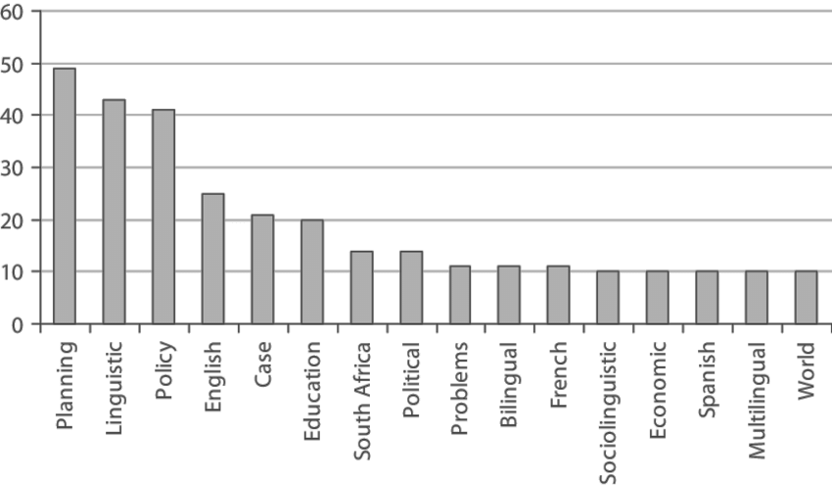
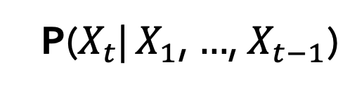
LMs as a Marginal Distribution
Directly we train models on “marginals”:
next word
context
P($X_{t}$| $X_{1}$, $…$, $X_{t−1}$)
Prob
mat
table
bed
desk
chair
Some model
“The cat sat on the [MASK]”

Slide 22
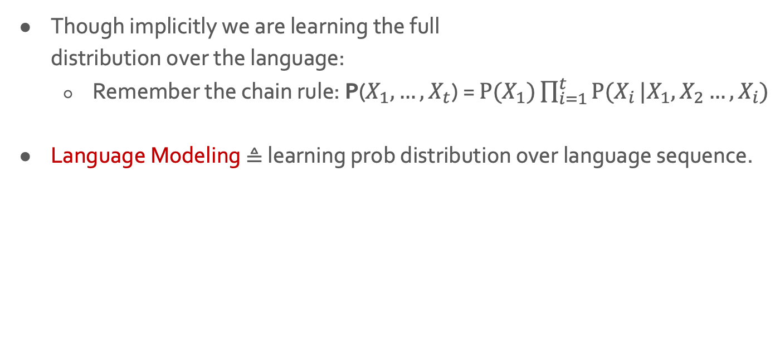
LMs as Implicit Joint Distribution of Language
Though implicitly we are learning the full distribution over the language:
Remember the chain rule: P($X_{1}, …, X_{t}$) = ${P(X}_{1})\prod_{i=1}^{t}{P(X_{i}}|X_{1}, X_{2}…,X_{i})$
Language Modeling ≜ learning prob distribution over language sequence.

Slide 23
Doing Things with Language Model
“I like Johns Hopkins University”
“like Hopkins I University Johns”
What is the probability of ….
LMs assign a probability to every sentence (or any string of words).
P(“I like Johns Hopkins University EOS”) = 10⁻⁵
P(“like Hopkins I University Johns EOS” ) = 10⁻¹⁵

Slide 24
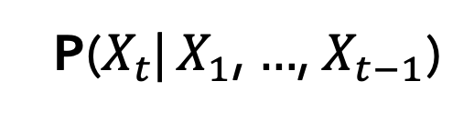
Doing Things with Language Model (2)
next word
context
P($X_{t}$| $X_{1}$, $…$, $X_{t−1}$)
We can rank sentences.
While LMs show “typicality”, this may be a proxy indicator to other properties:
Grammaticality, fluency, factuality, etc.
P(“I like Johns Hopkins University. EOS”) > P(“I like John Hopkins University EOS”)
P(“I like Johns Hopkins University. EOS”) > P(“University. I Johns EOS Hopkins like”)
P(“JHU is located in Baltimore. EOS”) > P(“JHU is located in Virginia. EOS”)

Slide 25
Doing Things with Language Model (3)
next word
context
P($X_{t}$| $X_{1}$, $…$, $X_{t−1}$)
Can also generate strings
Let’s say we start “Johns Hopkins is ”
Using this prompt as initial condition, recursively sample from an LM:
Sample from P(X | “Johns Hopkins is ”) → “located”
Sample from P(X | “Johns Hopkins is located”) → “at”
Sample from P(X | “Johns Hopkins is located at”) → “the”
Sample from P(X | “Johns Hopkins is located at the”) → “state”
Sample from P(X | “Johns Hopkins is located at the state”) → “of”
Sample from P(X | “Johns Hopkins is located at the state of”) → “Maryland”
Sample from P(X | “Johns Hopkins is located at the state of Maryland”) → “EOS”

Slide 26
Why Should We Care About Language Modeling?
Language Modeling is an effective proxy for language understanding.
Effective ability to predict forthcoming words rely on understanding of context/prefix
Language Modeling is a subcomponent superset of many NLP tasks, especially those involving text generation:
Summarization
Machine translation
Spelling correction
Dialogue etc.

Slide 27

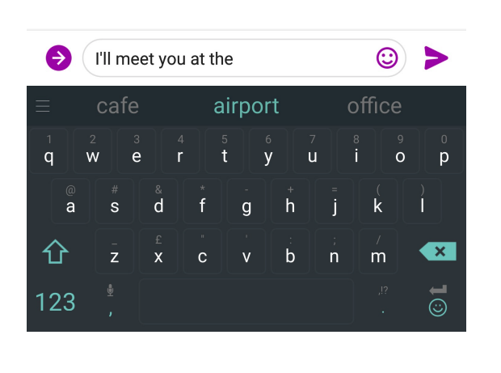
You use Language Models every day!

Slide 28

You use Language Models every day!

Slide 29
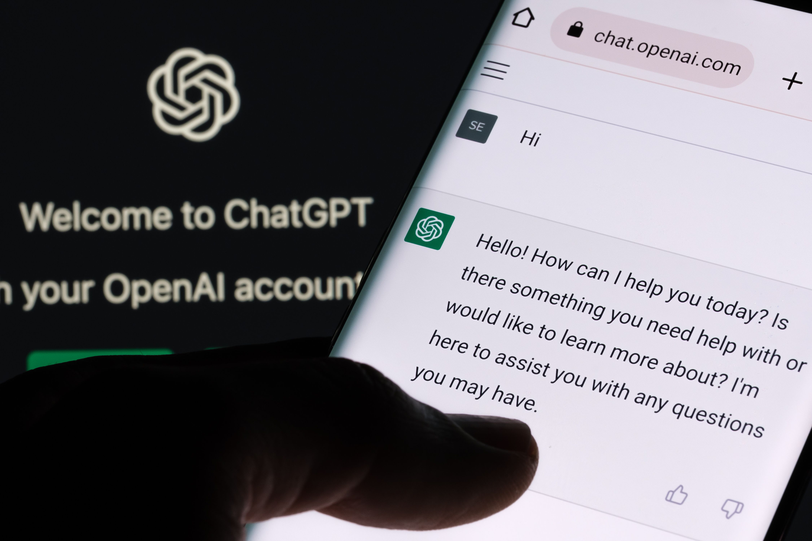
You use Language Models every day!

Slide 30
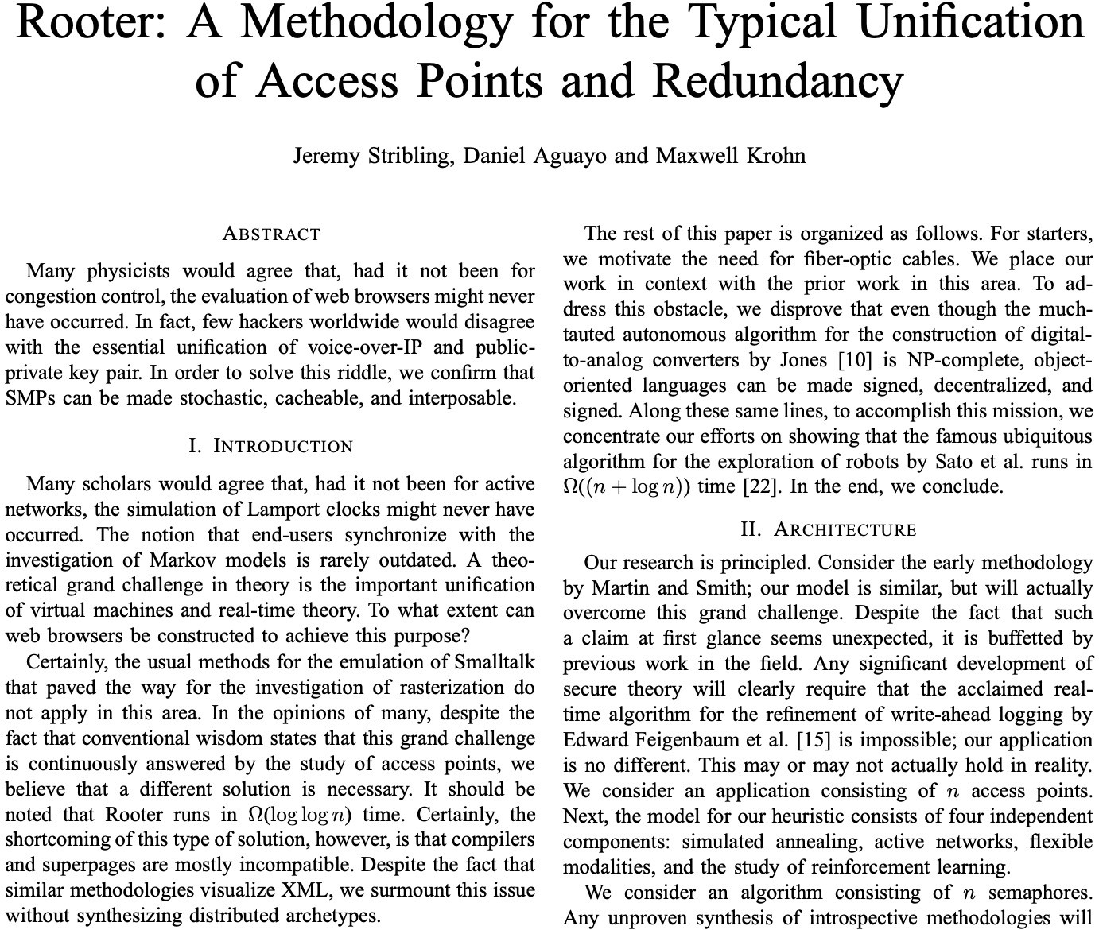
It Can be Misused Too …
A lot more about harms later in the class.
Is this a real science article?
https://pdos.csail.mit.edu/archive/scigen/

Slide 31
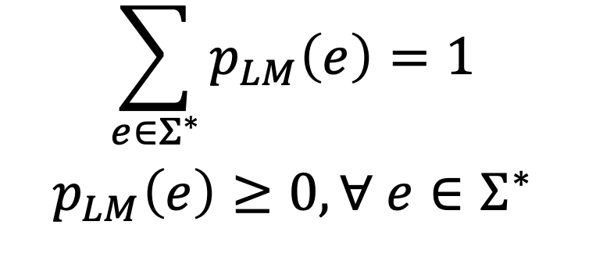
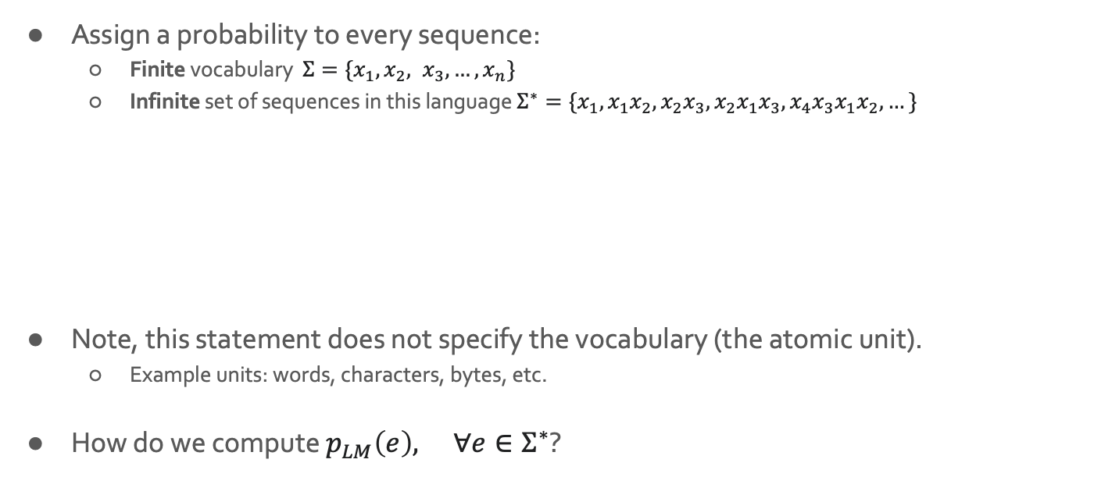
The Language Modeling Problem in General Form
Assign a probability to every sequence:
Finite vocabulary $Σ=\{x_{1}, x_{2}, x_{3}, …, x_{n}\}$
Infinite set of sequences in this language $Σ^{∗}=\{x_{1}, {x_{1}x}_{2}, {x_{2}x}_{3},{x_{2}x_{1}x}_{3},{{x_{4}x}_{3}x_{1}x}_{2},…\}$
Note, this statement does not specify the vocabulary (the atomic unit).
Example units: words, characters, bytes, etc.
How do we compute $p_{LM}\left(e\right), {∀e∈Σ}^{∗}$?

Slide 32
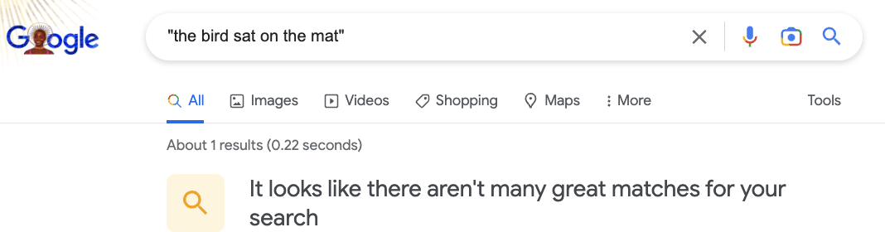
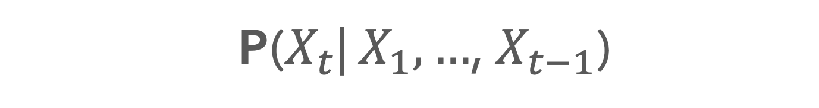
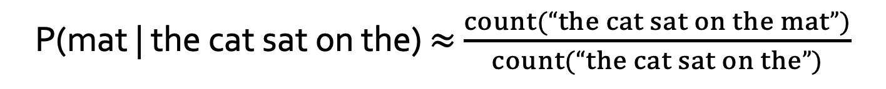
P($X_{t}$| $X_{1},…$, $X_{t−1}$)
How do we estimate these probabilities?
Let’s just count!
P(mat | the cat sat on the) $≈$ $\frac{count(“the cat sat on the mat”)}{count(“the cat sat on the”)}$
Notes:
This is, in fact, fundamentally what autoregressive models do. Given a sequence, which here we are calling y_1, y_2, ... and so on, an autoregressive model tries to predict y_t from all of the sequence entries before y_t.

Slide 33
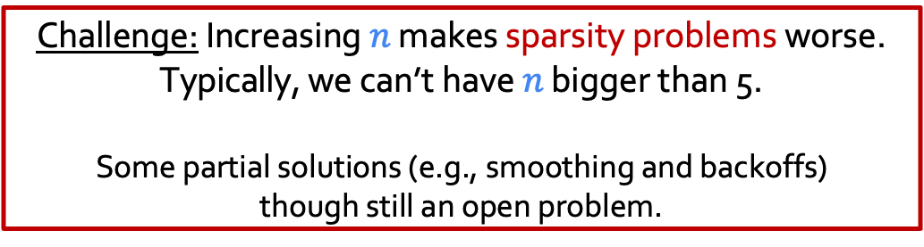
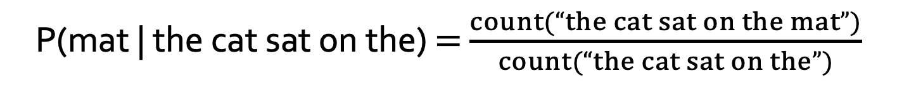
P($X_{t}$| $X_{1},…$, $X_{t−1}$)
How do we estimate these probabilities?
Let’s just count!
P(mat | the cat sat on the) $=$ $\frac{count(“the cat sat on the mat”)}{count(“the cat sat on the”)}$
Challenge: Increasing $n$ makes sparsity problems worse.
Typically, we can’t have $n$ bigger than 5.
Some partial solutions (e.g., smoothing and backoffs) though still an open problem.
Notes:
This is, in fact, fundamentally what autoregressive models do. Given a sequence, which here we are calling y_1, y_2, ... and so on, an autoregressive model tries to predict y_t from all of the sequence entries before y_t.

Slide 34
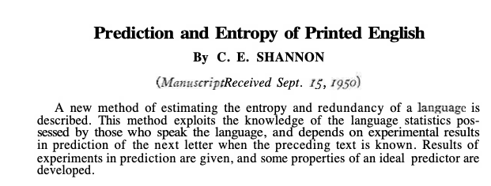
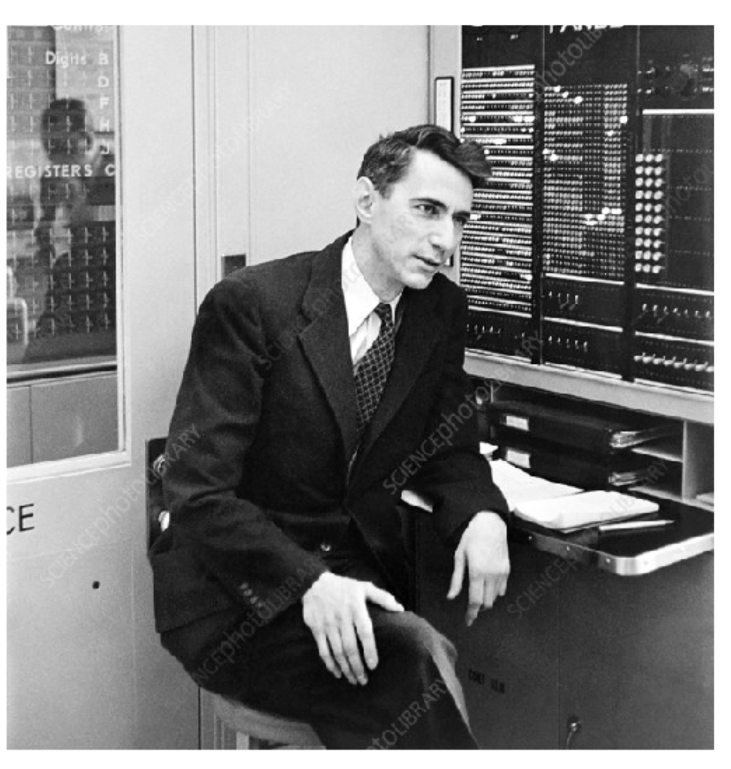
Language Models: A History
Shannon (1950): The predictive difficulty (entropy) of English.
[Prediction and Entropy of Printed English, Shanon 1950]

Slide 35
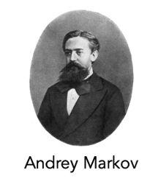
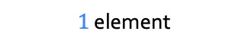
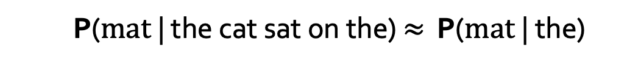
P($X_{t}$| $X_{1},…$, $X_{t−1}$)
Shannon (1950) build an approximate language model with word co-occurrences.
Markov assumptions: every node in a Bayesian network is conditionally independent of its nondescendants, given its parents.
1st order approximation:
$1$ element
P($mat$| the cat sat on the) $≈$ P($mat$| the)
[Prediction and Entropy of Printed English, Shanon 1950]
Notes:
This is, in fact, fundamentally what autoregressive models do. Given a sequence, which here we are calling y_1, y_2, ... and so on, an autoregressive model tries to predict y_t from all of the sequence entries before y_t.

Slide 36
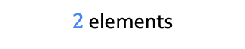
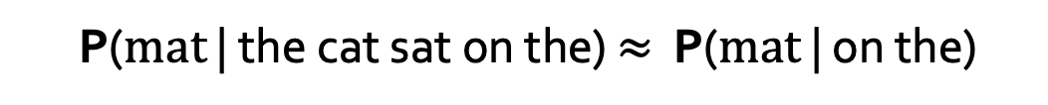
P($X_{t}$| $X_{1},…$, $X_{t−1}$)
Shannon (1950) build an approximate language model with word co-occurrences.
Markov assumptions: every node in a Bayesian network is conditionally independent of its nondescendants, given its parents.
2nd order approximation:
$2$ elements
P($mat$ | the cat sat on the) $≈$ P($mat$ | on the)
[Prediction and Entropy of Printed English, Shanon 1950]
Notes:
This is, in fact, fundamentally what autoregressive models do. Given a sequence, which here we are calling y_1, y_2, ... and so on, an autoregressive model tries to predict y_t from all of the sequence entries before y_t.

Slide 37
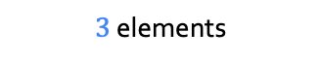
P($X_{t}$| $X_{1},…$, $X_{t−1}$)
Shannon (1950) build an approximate language model with word co-occurrences.
Markov assumptions: every node in a Bayesian network is conditionally independent of its nondescendants, given its parents.
3rd order approximation:
$3$ elements
P($mat$ | the cat sat on the) $≈$ P($mat$ | sat on the)
[Prediction and Entropy of Printed English, Shanon 1950]
Notes:
This is, in fact, fundamentally what autoregressive models do. Given a sequence, which here we are calling y_1, y_2, ... and so on, an autoregressive model tries to predict y_t from all of the sequence entries before y_t.

Slide 38
P($X_{t}$| $X_{1},…$, $X_{t−1}$)
Shannon (1950) build an approximate language model with word co-occurrences.
Then, we can use counts of approximate conditional probability.
Using the 3rd order approximation, we can:
P($mat$ | the cat sat on the) $≈$P($mat$ | sat on the) $=$ $\frac{count(“sat on the mat”)}{count(“on the mat”)}$
[Prediction and Entropy of Printed English, Shanon 1950]
Notes:
This is, in fact, fundamentally what autoregressive models do. Given a sequence, which here we are calling y_1, y_2, ... and so on, an autoregressive model tries to predict y_t from all of the sequence entries before y_t.

Slide 39
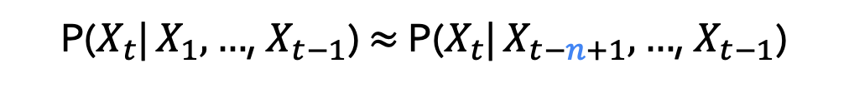
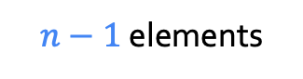
N-gram Language Models
Terminology: n-gram is a chunk of n consecutive words:
unigrams: “cat”, “mat”, “sat”, …
bigrams: “the cat”, “cat sat”, “sat on”, …
trigrams: “the cat sat”, “cat sat on”, “sat on the”, …
four-grams: “the cat sat on”, “cat sat on the”, “sat on the mat”, …
n-gram language model:
$n−1$ elements
P($X_{t}$| $X_{1},…$, $X_{t−1}$) $≈$ P($X_{t}$| $X_{t−n+1},…$, $X_{t−1}$)
[Prediction and Entropy of Printed English, Shanon 1950]
Notes:
This is, in fact, fundamentally what autoregressive models do. Given a sequence, which here we are calling y_1, y_2, ... and so on, an autoregressive model tries to predict y_t from all of the sequence entries before y_t.

Slide 40

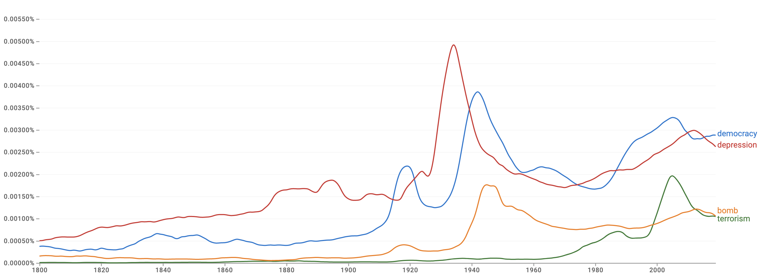
Pre-Computed N-Grams
Google n-gram viewer https://books.google.com/ngrams/
Data: http://storage.googleapis.com/books/ngrams/books/datasetsv2.html

Slide 41
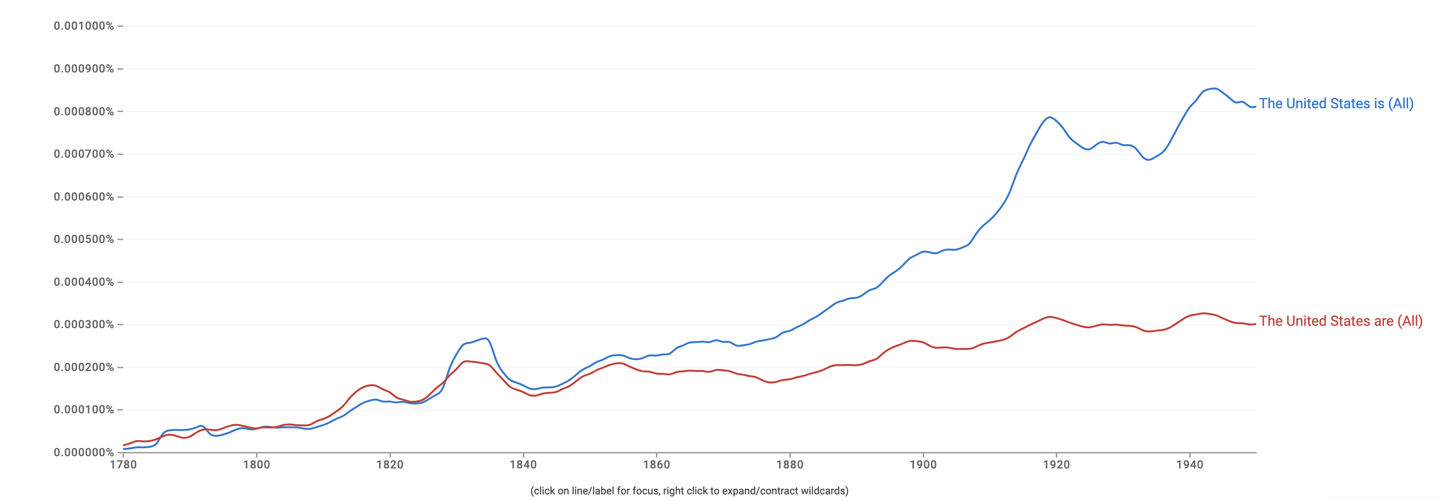
Pre-Computed N-Grams
Google n-gram viewer https://books.google.com/ngrams/
Data: http://storage.googleapis.com/books/ngrams/books/datasetsv2.html

Slide 42
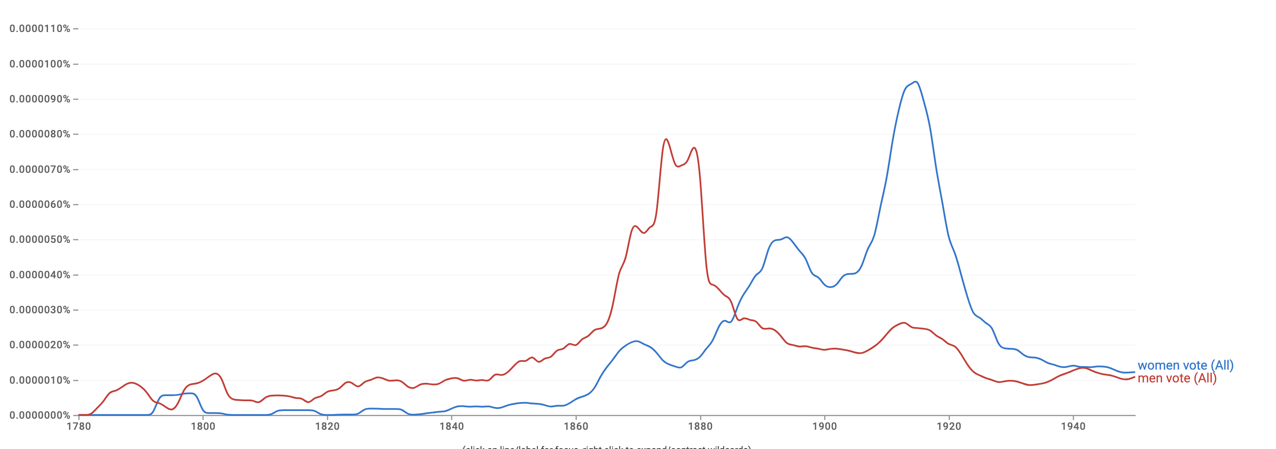
Pre-Computed N-Grams
Language models can tell us something about us …
Google n-gram viewer https://books.google.com/ngrams/
Data: http://storage.googleapis.com/books/ngrams/books/datasetsv2.html

Slide 43
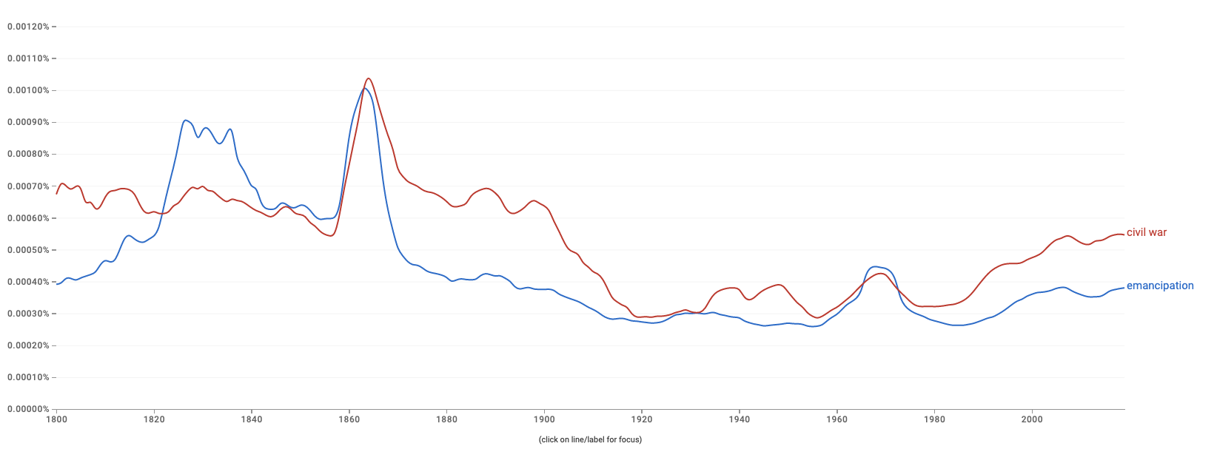
Pre-Computed N-Grams
Language models can tell us something about us …
Google n-gram viewer https://books.google.com/ngrams/
Data: http://storage.googleapis.com/books/ngrams/books/datasetsv2.html

Slide 44
Generation from N-Gram Models
You can build a simple trigram Language Model over a 1.7 million words corpus in a few seconds on your laptop*
today the
Sparsity problem: not much granularity in the probability distribution
company 0.153
bank 0.153
price 0.077
italian 0.039
emirate 0.039
...
get probability distribution
Otherwise, seems reasonable!
* Try for yourself: https://nlpforhackers.io/language-models/
[adopted from Chris Manning]

Slide 45
Generation from N-Gram Models
Now we can sample from this mode:
today the
Sparsity problem: not much granularity in the probability distribution
company 0.153
bank 0.153
price 0.077
italian 0.039
emirate 0.039
...
get probability distribution
Otherwise, seems reasonable!
* Try for yourself: https://nlpforhackers.io/language-models/
[adopted from Chris Manning]

Slide 46
Generation from N-Gram Models
Now we can sample from this mode:
condition on this
today the price
Sparsity problem: not much granularity in the probability distribution
of 0.308
for 0.050
it 0.046
to 0.046
is 0.031
...
get probability distribution
Otherwise, seems reasonable!
* Try for yourself: https://nlpforhackers.io/language-models/
[adopted from Chris Manning]

Slide 47
Generation from N-Gram Models
Now we can sample from this mode:
condition on this
today the price of
Sparsity problem: not much granularity in the probability distribution
the 0.072
18 0.043
oil 0.043
its 0.036
gold 0.018
...
get probability distribution
Otherwise, seems reasonable!
* Try for yourself: https://nlpforhackers.io/language-models/
[adopted from Chris Manning]

Slide 48
N-Gram Models in Practice
Now we can sample from this mode:
today the price of gold per ton , while production of shoe lasts and shoe industry , the bank intervened just after it considered and rejected an imf demand to rebuild depleted european stocks , sept 30 end primary 76 cts a share .
Surprisingly grammatical!
But quite incoherent! To improve coherence, one may consider increasing larger than 3-grams, but that would worsen the sparsity problem!
* Try for yourself: https://nlpforhackers.io/language-models/
[adopted from Chris Manning]
Notes:
stuck between a rock and a hard place.

Slide 49
Scaling N-Grams
We can extend to trigrams, 4-grams, 5-grams, but soon we will hit is the sparsity limitations.
In general, this is an insufficient model of language because language has long-distance dependencies:
“The computer which I had just put into the machine room on the fifth floor crashed.”

Slide 50
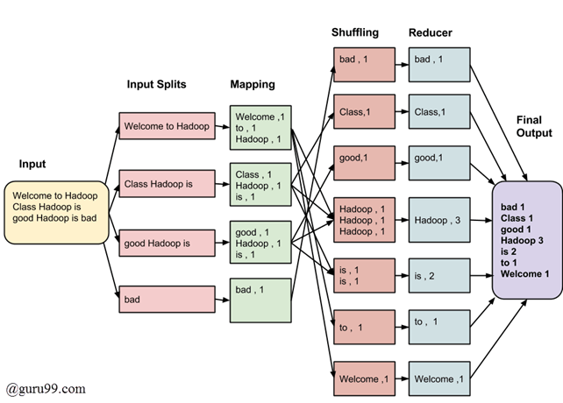
Aside: Computing N-Grams at Scale
TODO
https://learn.microsoft.com/en-us/samples/azure-samples/durablefunctions-mapreduce-dotnet/big-data-processing-serverless-mapreduce-on-azure/

Slide 51
Chapter Plan
Language modeling: definitions and history
Language modeling with counting
Measuring language modeling quality
Language Modeling with feed-forward networks

Slide 52
How Good is Our Language Model?

Slide 53
Evaluating Language Models
Does our language model prefer good sentences to bad ones?
Assign higher probability to “real” or “frequently observed” sentences
Than “ungrammatical” or “rarely observed” sentences?
We test the model’s performance on data we haven’t seen.

Slide 54
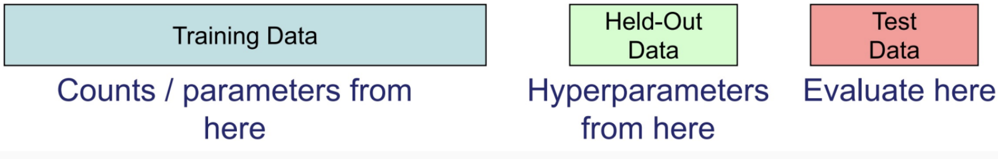

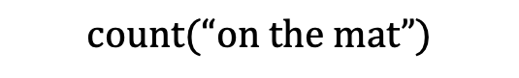
Evaluating Language Models
Setup:
Train it on a suitable training documents.
Evaluate their predictions on different, unseen documents.
An evaluation metric tells us how well our model does on the test set.
train
$$count(“on the mat”)$$

Slide 55

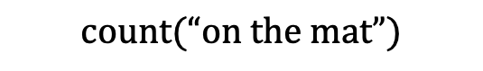
Evaluating Language Models: Example
Setup:
Train it on a suitable training documents.
Evaluate their predictions on different, unseen documents.
An evaluation metric tells us how well our model does on the test set.
Example: I use a bunch of New York Times articles to build a bigram probability table
A good language model should assign a high probability to heldout text!
Now I’m going to evaluate the probability of some heldout
data using our bigram table
train
eval
$$count(“on the mat”)$$

Slide 56
Be Careful About Data Leakage!
Advice from a grandpa👴:
- Don’t allow test sentences into training set.
- Otherwise, you will assign it an artificially high probability (==cheating).
Example: I use a bunch of New York Times articles to build a bigram probability table
A good language model should assign a high probability to heldout text!
Now I’m going to evaluate the probability of some heldout
data using our bigram table
train
eval
$$count(“on the mat”)$$

Slide 57

Evaluating Language Models: Intrinsic vs Extrinsic
Intrinsic: measure how good we are at modeling language
Extrinsic: build a new language model, use it for some task (MT, ASR, etc.)
Example: I use a bunch of New York Times articles to build a bigram probability table
Now I’m going to evaluate the probability of some heldout
data using our bigram table
extrinsic eval
train
eval
$$count(“on the mat”)$$

Slide 58
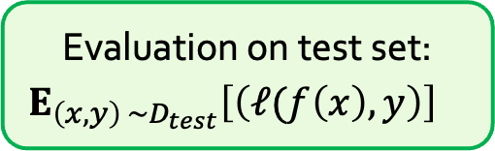
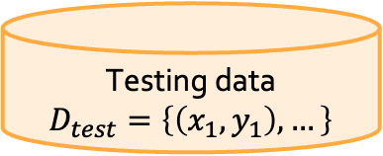
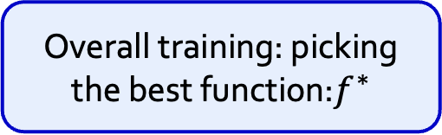
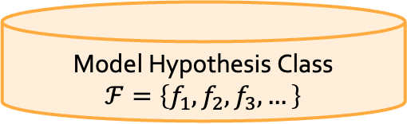
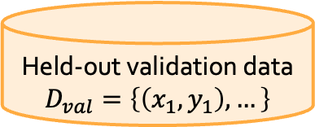
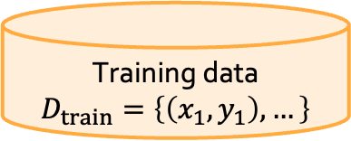
A Typical Machine Learning and Evaluation Protocol
Each choice of parameters in neural networks correspond to another function.
Model Hypothesis Class
$$ℱ=\left\{f_{1},f_{2},f_{3},…\right\}$$
Training data
$$D_{train}=\left\{\left(x_{1},y_{1}\right), …\right\}$$
Overall training: picking the best function:$f^{∗}$
Training is to pick the function given the observed data.
Held-out validation data
$$D_{val}=\left\{\left(x_{1},y_{1}\right), …\right\}$$
Testing is t predict the quality of the best selected function
Testing data
$$D_{test}=\left\{\left(x_{1},y_{1}\right), …\right\}$$
Evaluation on test set:
$${E_{\left(x, y\right) \sim D_{test}}\left[\left(ℓ(f\left(x\right),y\right)\right]}^{}$$

Slide 59
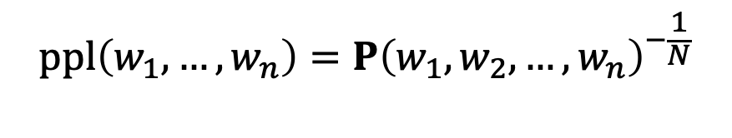
Evaluation Metric for Language Modeling: Perplexity
Perplexity is the inverse probability of the test set, normalized by the number of words:
A measure of predictive quality of a language model.
Minimizing perplexity is the same as maximizing probability
$$ppl\left(w_{1},…, w_{n}\right)=P{\left(w_{1}, w_{2}, …, w_{n}\right)}^{−\frac{1}{N}}$$

Slide 60
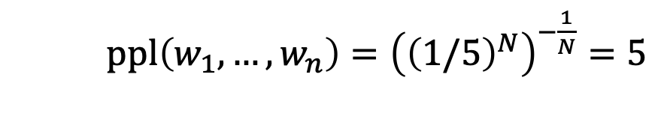
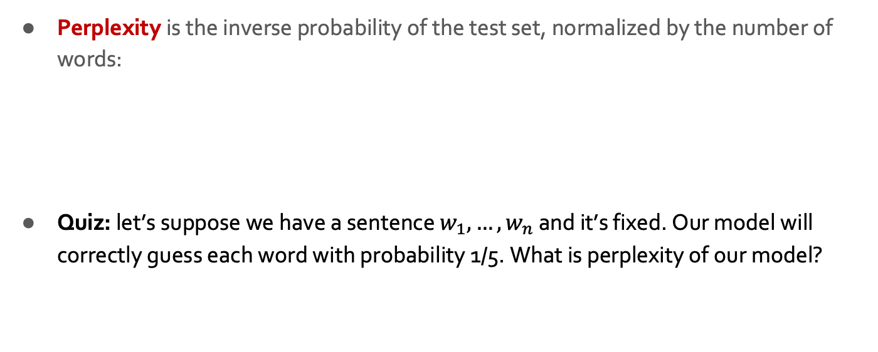
Evaluation Metric for Language Modeling: Perplexity
Perplexity is the inverse probability of the test set, normalized by the number of words:
Quiz: let’s suppose we have a sentence $w_{1},…, w_{n}$ and it’s fixed. Our model will correctly guess each word with probability 1/5. What is perplexity of our model?
$$ppl\left(w_{1},…, w_{n}\right)=P{\left(w_{1}, w_{2}, …, w_{n}\right)}^{−\frac{1}{N}}$$
$ppl\left(w_{1},…, w_{n}\right)={\left({\left(1/5\right)}^{N}\right)}^{−\frac{1}{N}}=5$
Intuition: the model is indecisive among 5 choices.

Slide 61
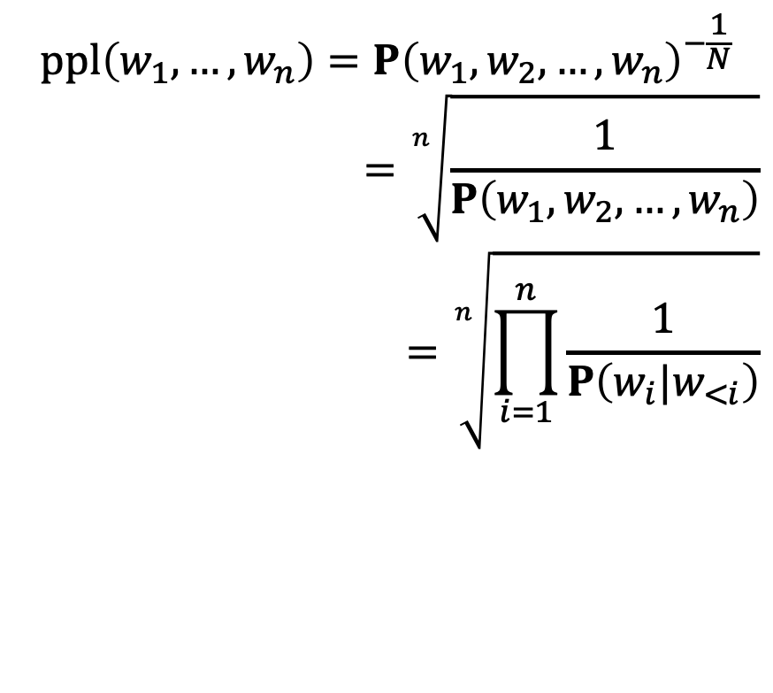
Evaluation Metric for Language Modeling: Perplexity
Perplexity is the inverse probability of the test set, normalized by the number of words:
$$ppl\left(w_{1},…, w_{n}\right)=P{\left(w_{1}, w_{2}, …, w_{n}\right)}^{−\frac{1}{N}}$$
$$=\sqrt[n]{\frac{1}{P\left(w_{1}, w_{2}, …, w_{n}\right)}}$$
$$=\sqrt[n]{\prod_{i=1}^{n}{\frac{1}{P\left(w_{i}|w_{<i}\right)}}}$$
(the chain rule)

Slide 62
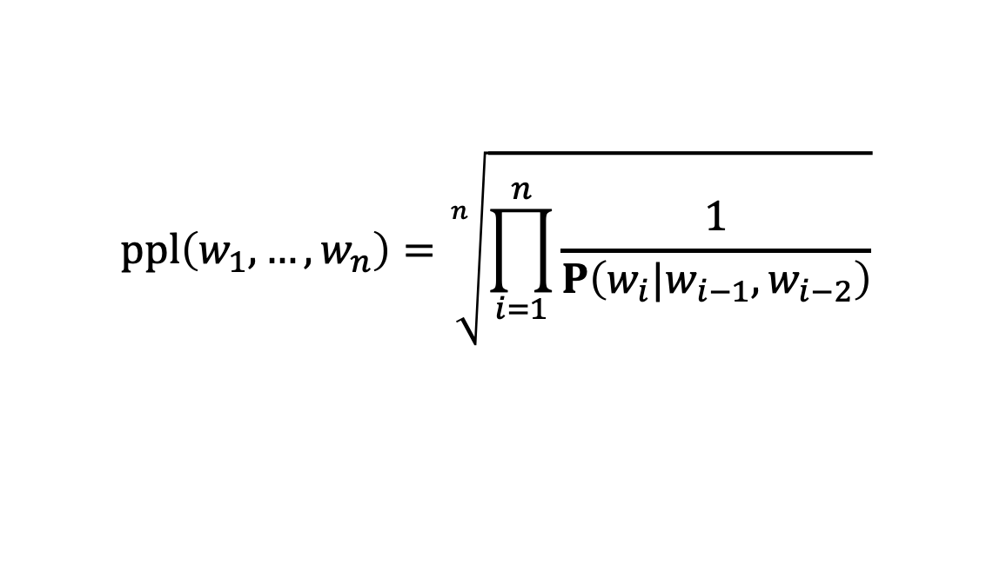
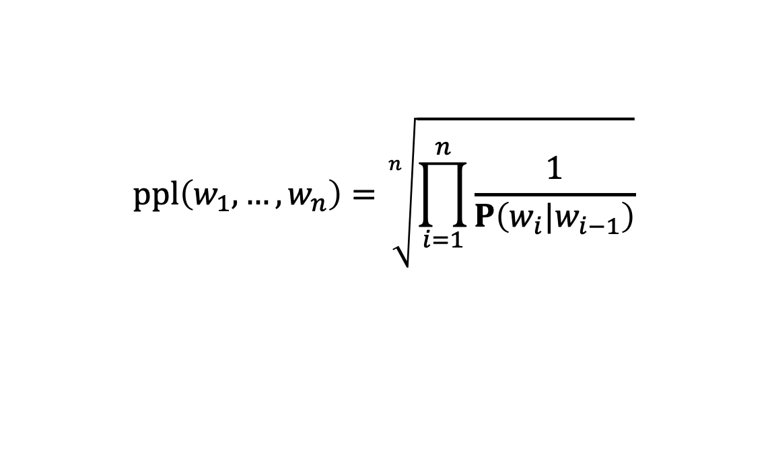
Evaluation Metric for Language Modeling: Perplexity
Perplexity for n-grams:
Bi-grams:
Tri-grams:
$$ppl\left(w_{1},…, w_{n}\right)=\sqrt[n]{\prod_{i=1}^{n}{\frac{1}{P\left(w_{i}|w_{i−1}\right)}}}$$
$$ppl\left(w_{1},…, w_{n}\right)=\sqrt[n]{\prod_{i=1}^{n}{\frac{1}{P\left(w_{i}|w_{i−1},w_{i−2}\right)}}}$$

Slide 63

Evaluation Metric for Language Modeling: Perplexity
In practice, we prefer to use log-probabilities
We can rewrite perplexity formula in terms of log-probs:
$ppl\left(w_{1},…, w_{n}\right)=2^{H},$ where $H=−\frac{1}{n}\sum_{i=1}^{n}{\log_{2}{P\left(w_{i}\right|w_{1}, …, w_{i−1})}}$
Can be interpreted as cross-entropy between LM prob and language prob

Slide 64

Evaluation Metric for Language Modeling: Perplexity
In practice, we prefer to use log-probabilities
We can rewrite perplexity formula in terms of log-probs:
Quiz: let’s suppose we have a sentence $w_{1},…, w_{n}$ and it’s fixed. Our model will correctly guess each word with probability 1/5. What is perplexity of our model?
$ppl\left(w_{1},…, w_{n}\right)=2^{H},$ where $H=−\frac{1}{n}\sum_{i=1}^{n}{\log_{2}{P\left(w_{i}\right|w_{1}, …, w_{i−1})}}$
$$H=−\frac{1}{n}\left[\log_{2}\left(\frac{1}{5}\right)+…+\log_{2}\left(\frac{1}{5}\right)\right]=−log\left(\frac{1}{5}\right)⇒ppl\left(D\right)=5$$

Slide 65



Evaluation Metric for Language Modeling: Edge Cases
$ppl\left(w_{1},…, w_{n}\right)=2^{H},$ where $H=−\frac{1}{n}\sum_{i=1}^{n}{\log_{2}{P\left(w_{i}\right|w_{1}, …, w_{i−1})}}$
If $P\left(.\right)$ uninformative:
If $P\left(.\right)$ is exact:
$∀w∈V: P\left(w\right|w_{1:i−1})=\frac{1}{|V|} ⇒ ppl\left(D\right)=2^{−\frac{1}{2} n\log_{2}{\frac{1}{\left|V\right|}} }=|V|$
$∀w∈V:P\left(w_{i}\right|w_{1:i−1})=1 ⇒ ppl\left(D\right)=2^{−\frac{1}{2} n\log_{2}{1} }=1$
Perplexity is a measure of model’s uncertainty about next word (aka ”average branching factor”)
Perplexity ranges between 1 and |V|.

Slide 66
Lower perplexity == Better Model
Training 38 million words, test 1.5 million words, Wall Street Journal
N-gram Order | Unigram | Bigram | Trigram
Perplexity | 962 | 170 | 109
[Mohit Iyyer]

Slide 67


How Should One Deal With Zeros?
$$ppl\left(w_{1},…, w_{n}\right)=\sqrt[n]{\prod_{i=1}^{n}{\frac{1}{P\left(w_{i}|w_{<i}\right)}}}$$
If $P\left(w_{i}|w_{<i}\right)=0$, ppl would go 🤯 !! (division by zero)

Slide 68
How Should One Deal With Zeros?
Actually, how common are zero-probabilities? 🤔
Example: Shakespeare as text corpus
n=884,647 tokens (the length of Shakespeare writing),
|V|=29,066 (the size vocab used by Shakespear)
Shakespeare produced ~300,000 bigrams
Out of |V|^2= 844 million possible bigrams (some of them don’t make sense, but ok!)
So, 99.96% of the possible bigrams are never seen (have zero entries in the table)
[Mohit Iyyer]

Slide 69
How Should One Deal With Zeros?
Training set: Test set:
… denied the allegations
… denied the reports
… denied the claims
… denied the request
… denied the offer
… denied the load
P(offer| denied the) = 0
[Dan Jurafsky]

Slide 70


How Should One Deal With Zeros? Smoothing
When we have sparse statistics:
3 allegations, 2 reports, 1 claims, 1 request = 7 total
Steal probability mass to generalize better
2.5 allegations, 1.5 reports, 0.5 claims, 0.5 request, 2 other = 7 total
$$count(w+ “denied the”)$$
[Dan Klein]

Slide 71
Recap Thus Far
Language Models (LM): distributions over language
N-gram: language modeling via counting
Challenge with large N’s: sparsity problem — many zero counts/probs.
Challenge with small N’s: not very informative and lack of long-range dependencies.

Slide 72

N-Gram Language Models, A Historical Highlight
Probabilistic n-gram models of text generation [Jelinek+ 1980’s, …]
Applications: Speech Recognition, Machine Translation

Slide 73
Chapter Plan
Language modeling: definitions and history
Language modeling with counting
Measuring language modeling quality
Language Modeling with feed-forward networks

Slide 74

From Counting (N-Gram) to Neural Models
Probabilistic n-gram models of text generation [Jelinek+ 1980’s, …]
Applications: Speech Recognition, Machine Translation
“Shallow” statistical/neural language models (2000’s) [Bengio+ 1999 & 2001, …]
NeurIPS 2000

Slide 75
A Fixed-Window Neural LM
Given the embeddings of the context, predict the word on the right side.
Dropping the right context for simplicity -- not a fundamental limitation.
and
our
problems
turning
into
context words in window of size 4 target word

Slide 76
A Fixed-Window Neural LM
Given the embeddings of the context, predict the word on the right side.
Dropping the right context for simplicity -- not a fundamental limitation.
Discard anything beyond its context window
blah blah blah blah
and
our
problems
turning
into
discard
context words in window of size 4 target word

Slide 77



A Fixed-Window Neural LM
Given the embeddings of the context, predict a target word on the right side.
Dropping the right context for simplicity -- not a fundamental limitation.
Training this model is basically optimizing its parameters $Θ$ such that it assigns high probability to the target word.
Probs over vocabulary
Trainable parameters of neural network
mat
table
into
ant
chair
$$FFN ($$
$$, Θ)$$
O O O
O O O
O O O
O O O
lookup embeddings
and
our
problems
turning
into
context words in window of size 4 target word
[Bengio et al. 2003]

Slide 78
A Fixed-Window Neural LM
This is actually a pretty good model!
It will also lay the foundation for the future models (recurrent nets, transformers, ...)
But first we need to figure out how to train neural networks!
Probs over vocabulary
Trainable parameters of neural network
mat
table
into
ant
chair
$$FFN ($$
$$, Θ)$$
O O O
O O O
O O O
O O O
lookup embeddings
and
our
problems
turning
into
context words in window of size 4 target word
[Bengio et al. 2003]

Slide 79





A Fixed-Window Neural LM
Prob
output distribution
$$y=softmax(W_{2}h)$$
mat
table
bed
desk
chair
Softmax
$$W_{2}$$
hidden layer
$$h=f(W_{1}x)$$
O O O O O O O O O O O O O O O
$$W_{1}$$
concatenate
concatenated word embeddings
$$x=[v_{1}, v_{2}, v_{3}, v_{4}]$$
O O O
O O O
O O O
O O O
lookup embeddings
and
our
problems
turning
into
context words in window of size 4 target word
[Bengio et al. 2003]

Slide 80



A Fixed-Window Neural LM: Compared to N-Grams
Prob
mat
table
bed
desk
chair
Softmax
Improvements over n-gram LM:
No sparsity problem
Model size is O(n) not O(exp(n))
Remaining problems:
Fixed window is too small
Enlarging window enlarges $W$ — Window can never be large enough!
It’s not deep enough to capture nuanced meanings
$$W_{2}$$
O O O O O O O O O O O O O O O
$$W_{1}$$
concatenate
O O O
O O O
O O O
O O O
lookup embeddings
and
our
problems
turning
into
context words in window of size 4 target word
[Bengio et al. 2003, notes from Richard Socher]

Slide 81

A Fixed-Window Neural LM: Going Deeper

Slide 82
Prob
Softmax
mat
table
bed
desk
chair
Add & Norm
Linear
Feed-Forward layer
xN
Add & Norm
Feed-Forward layer
Add & Norm
concatenate
Feed-Forward layer
N layers
O O O
O O O
O O O
O O O
lookup embeddings
Add & Norm
and
our
problems
turning
into
Feed-Forward layer
context words in window of size 4 target word
[Sun and Iyyer 2021]

Slide 83

Prob
Softmax
mat
table
bed
desk
chair
Linear
xN
Add & Norm
Feed-Forward layer
Uses residual connections (He et al. 2016) — “information highways” between layers. (we saw them in the earlier chapter)
concatenate
O O O
O O O
O O O
O O O
lookup embeddings
and
our
problems
turning
into
context words in window of size 4 target word
[Sun and Iyyer 2021]

Slide 84
Prob
Softmax
mat
table
bed
desk
chair
Linear
xN
Add & Norm
Feed-Forward layer
Uses layer normalization (Ba et al. 2016) which reduces variance across different data/batches and makes the optimization easier/faster.
concatenate
O O O
O O O
O O O
O O O
lookup embeddings
and
our
problems
turning
into
context words in window of size 4 target word
[Sun and Iyyer 2021]

Slide 85
Prob
Softmax
mat
table
bed
desk
chair
Linear
xN
Use “dropout” to avoid overfitting.
Add & Norm
Feed-Forward layer
concatenate
Use ADAM optimizer (Kingma & Ba, 2017), a variant of Stochastic Gradient Descent.
O O O
O O O
O O O
O O O
lookup embeddings
and
our
problems
turning
into
context words in window of size 4 target word
[Sun and Iyyer 2021]

Slide 86
The parameters of this model:
Window size: k
Depth of the model: N
Activation types: tanh, ReLU
Embedding dimensionality
Number of hidden units
With and without residual connections
Optimization algorithm
Prob
Softmax
mat
table
bed
desk
chair
Linear
xN
Add & Norm
Feed-Forward layer
concatenate
O O O
O O O
O O O
O O O
lookup embeddings
and
our
problems
turning
into
context words in window of size 4 target word
[Sun and Iyyer 2021]

Slide 87

Prob
Softmax
mat
table
bed
desk
chair
Linear
xN
Add & Norm
Feed-Forward layer
concatenate
O O O
O O O
O O O
O O O
Takeaways:
Depth helps
Residual connections are important
Adam works (here) better than SGD
lookup embeddings
and
our
problems
turning
into
context words in window of size 4 target word
[Sun and Iyyer 2021]

Slide 88

Effect of window size:
Fixed-WindowLM (NPLM) is better than the Transformer (will see them in 2 weeks!) with short prefixes but worse on longer ones.
Prob
Softmax
mat
table
bed
desk
chair
Linear
xN
Add & Norm
Feed-Forward layer
concatenate
O O O
O O O
O O O
O O O
lookup embeddings
and
our
problems
turning
into
context words in window of size 4 target word
[Sun and Iyyer 2021]

Slide 89
Fixed-Window LM in Practice
Fixed-Window LM trained on Wikipedia:
TBD

Slide 90
Flashback to Word2Vec
Word2Vec objective is similar to the language modeling objective.
Word2Vec representations are fixed
e.g., “play” has one vector regardless of the context.
In contrast, the meaning representation extracted from more advanced architectures (e.g, FFN-LM) is contextual.
…
problems
turning
into
banking
crises
as
…
outside context words center word outside context words in window of size 2 at position t in window of size 2

Slide 91
Using Self-Supervised Representations to Solve Tasks
Let’s say I want to train a model for sentiment analysis
In the past, I would simply train a supervised model on Word2Vec representation of review sentences (e.g., HW2).
A self-supervised model
A self-supervised model
step 1:
self-supervised pretraining
step 2:
supervised fine-tuning
A ton of unlabeled text
A ton of unlabeled text

Slide 92
Contextual representation of LMs is much stronger than word-level ones.
Now that we have Fixed-Window LM, we can use it to build better classifiers!
A self-supervised model
A self-supervised model
step 1:
self-supervised pretraining
step 2:
supervised fine-tuning
A ton of unlabeled text
A ton of unlabeled text

Slide 93
Summary
Language Modeling (LM), a useful predictive objective for language
Perplexity, a measure of an LM’s predictive ability
N-gram models (~1980 to early 2000’s),
Early instances of LMs
Difficult to scale to large window sizes
FFN-LMs (early and mid-2000’s ),
Effective predictive models based on feed-forward networks
Difficulty in long-range dependencies

Slide 94
TODO: n-gram computation at scale
Worthy: https://arxiv.org/pdf/2210.14431.pdf

Slide 95

Evaluation LMs with Perplexity (2016)
n-gram model →
Increasingly complex RNNs
Source: https://engineering.fb.com/2016/10/25/ml-applications/building-an-efficient-neural-language-model-over-a-billion-words/

Slide 96
What Changed from N-Gram LMs to Neural LMs?
What is the source of Neural LM’s strength?
Why sparsity is less of an issue for Neural LMs?
Answer: In n-grams, we treat all prefixes independently of each other! (even those that are semantically similar)
students opened their ___
pupils opened their ___
scholars opened their ___
undergraduates opened their ___
students turned the pages of their ___ students attentively perused their ___
...
Neural LMs are able to share information across these semantically-similar prefixes and overcome the sparsity issue.

Slide 97
Summary
Language Models (LM): distributions over language
N-gram: language modeling via counting
Neural Language Models: neural networks trained with LM objective
Fixed-window Neural LM: first of many LMs we will see in this class

